Slide 1
Basic Introduction to
SQL
By: Supriya Agrawal
Assistant Professor
Computer Engineering Deptt.
MPSTME, NMIMS UNIVERSITY

Slide 2
Introduction to Oracle Database
Oracle is the world’s most popular DBMS.
It is a powerful and robust DBMS that runs on many different operating systems.
Oracle is a object relational database management system.
Example of Oracle products:
  SQL*Plus
  Oracle Developer
  Oracle Designer

Slide 3
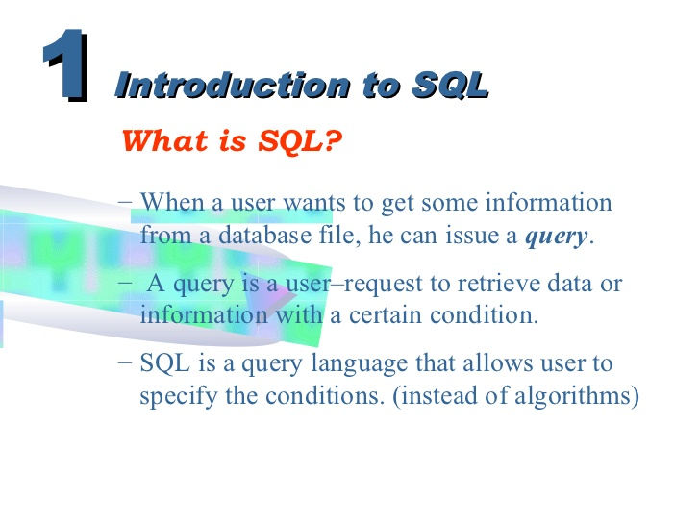

Slide 4
SQL
Language developed by IBM (1970s) to manipulate the data stored in database system
Originally called “Structured English Query Language” (SEQUEL), later it is called SQL “Structured Query language”.
It is the standard language for relational database management systems.
It is a nonprocedural language(means what rather than how).
For Example: Select “customer name” from customer database where rs. in account > 10,000

Slide 5
SQL has several parts:
  Data Definition Language (DDL)- Create or modify the database structure
    1. Create
    2. Drop
    3. Alter
  Data Manipulation Language (DML) – ability to query information from the database (like select) and to insert, update or delete database structure.
  Integrity – commands for specifying integrity constraints that the data stored in the database must satisfy.
  View Definition – SQL DDL defines commands for defining views.
  Transaction Control – commands for specifying the beginning and ending of transaction.
  Authorization – commands for specifying access rights to relations and views.

Slide 6
SQL Data Definition
SQL DDL allows set of relations and information about each relation including:
  Schema for each relation
  types of each value associated with each attribute
  integrity constraints
  security and authorization information for each relation
  physical storage structure of each relation on disk

Slide 7
SQL*Plus
SQL*Plus is a text editor.
SQL*Plus can be used to:
  Enter SQL statements.
  Submit SQL files created by text editors, e.g. notepad, to Oracle server.
The semicolon (;) terminates a SQL statement.

Slide 8
SQL
Oracle Server
SQL*PLUS
Text Editor
Command Language
Access Data

Slide 9
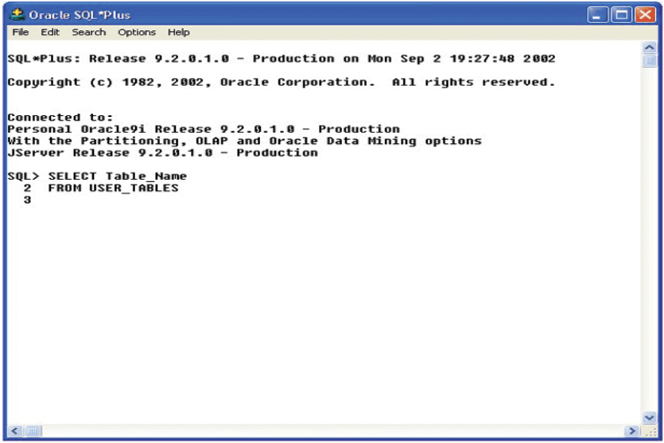
SQL*Plus Prompt

Slide 10
Basic Data Types
Data type | Description
CHAR (SIZE) | Character strings value of fixed length. Max characters can hold is 255. The data held is right padded with spaces to whatever length is specified. For example: Name CHAR(7)= NMIMS--
VARCHAR (SIZE)/VARCHAR2(SIZE) | Store variable length of alpha numeric type. Max characters can hold 255. Inserted values will not be padded with spaces. For example: Name VarCHAR(7)= NMIMS
Number (size) | store numbers only

Slide 11
Data Type | Description
Number (P,S) | store fixed or floating numbers where p is precision and s is scale. Max precision is 38 digits. for example- numeric(7,2) means 5 digits before decimal and 2 digits after decimal.
DATE | represent date and time. standard format is DD-MON-YY
LONG | store variable length character string upto 2GB. LONG data can not be used in sub queries, or functions
int or integer | machine dependent finite set of integers.
Float(n) | floating point number with precision of at least n digits.

Slide 12
Data Languages in SQL
DDL (Data Definition Language)
  Create, Alter, Truncate, Drop, Rename
DML (Data Manipulation Language)
  Insert, Select, Update, Delete
TCL (Transaction Control Language)
  Commit , Rollback

Slide 13
Basic Commands of DDL
Create Table
Syntax:
Create table <table name>
(<column name1> <datatype>(<size>),
<column name2> <datatype>(<size>)………
<column nameN> <datatype>(<size>));
Create table student(name varchar2(10), city varchar2(10), class varchar2(10), marks number(5));
Output:
Table Created

Slide 14
(2) Alter Command
Modify the structure of a table: add, delete or rename the table name, also change the data type of existing column
Adding a new column:
Syntax:
Alter table <table name> ADD ( < NewColumn1> <Datatype> (size), ….. < NewColumnN> <Datatype> (size) );
For Example:
Alter table Student ADD ( Marks number(5));
Name | City | Class | Marks

Slide 15
Dropping a column from a table
Syntax:
Alter Table <Table Name> DROP Column <Column Name>;
For Example: Drop the column name Marks from the student table
Alter Table Student DROP COLUMN Marks;
Name | City | Class
John | Mumbai | B.Tech
Rahul | Mumbai | MCA

Slide 16
C ) Modifying Existing Columns
Syntax:
Alter Table <Table Name> MODIFY (<Column Name> <New Datatype> (<NewSize>) );
For Example: Alter Student table to allow NAME field to store alphanumeric datatype upto 30 characters.
Alter Table Student MODIFY (Name varchar2(30) );
Limitations of Alter Command
Can not change the table name
Can not change the column name

Slide 17
(3) Rename Command
Rename the table name
Syntax
RENAME <Tablename> TO < NewTableName>;
Alter table <table name> Rename to <New Table name>
For Example: Rename student table name to student record
RENAME Student TO Student_Record;
Alter table student rename to student_record;

Slide 18
(4) Drop Command
The DROP command removes a table from the database. All the tables' rows, indexes and privileges will also be removed.
Syntax
Drop Table <Tablename>;
(5) Truncate Command
TRUNCATE removes all rows from a table.
Syntax
Truncate Table <Tablename>;

Slide 19
Insert Command
Commands of DML
Syntax:
Insert into <table name> (<column name1>, <colum name2>…….<column nameN> ) values (<expression 1>, <expression2>……..<expressionN>);
Insert into student (Name, City, Class, marks) values (‘John’, ‘mumbai’, ‘B.Tech’, 3);
Insert into student values (‘Rahul’, ‘Delhi’, ‘MCA 1’, 7);
Insert into student (name) values (‘rahul’);
Output:
2 rows created
Char
Number
VarChar

Slide 20
Insert Null Values
Syntax:
INSERT INTO <table_name> ( Column1, column2 )
VALUES ( Value1, null);
Insert All: for inserting multiple values
Syntax:
Insert All
into <Table name> ( Column1, column2 ) VALUES ( Value1, value2)
into <Table name> ( Column1, column2 ) VALUES ( Value2, value3);

Slide 21
For example
insert all
into Student(name, marks) values(‘John', 1)
into student (name, marks) values(‘Roy', 3)
into student(name, marks) values(‘ram', 4);
For inserting Multiple values:
Insert into <table name>(Column1, column 2, ….column n) values(&Column1, '&column2',… &column n);
For Example:
insert into emp (empno, ename, sal) values(&empno, '&ename', &sal);
Enter value for empno: 123
Enter value for ename: RADHI
Enter value for sal: 25000

Slide 22
Select Command
It is used for retrieving the records from the database
Syntax:
  Select * from tab;
  (This command is used to show the entire tables of the database)
  Select * from tablename;
  (This command is used to show the entire record of the particular table)
  Example: Select * from student;
  Select <column name>, <column name>……<n column name> from tablename;
  Example: select name, marks from student;

Slide 23
Table in SQL
Select * from student
Student
Name | City | Class
John | Mumbai | 2
Rahul | Delhi | MCA 1

Slide 24
Table in SQL
Student
Name
John
Rahul
Select name from student

Slide 25
Filtering Table Data
Selected columns and all rows
Selected rows and all columns
selected columns and selected rows

Slide 26
Selected columns and all rows:-
Retrieval of specific columns from a table
Syntax::
select <column1>, <column2> from <table name>;
Select name , city from student;
Name | City
John | Mumbai
Rahul | Delhi

Slide 27
Selected rows and all columns:- using where clause
Retrieval of specific rows from a table
Syntax::
select * from <table name> where<condition>;
Select * from student where name=‘john’;
Name | City | Class
John | Mumbai | 2

Slide 28
Selected rows and selected columns:-
Retrieval of specific rows and specific column from a table
Syntax::
select <column1>, <column2> from <table name> where<condition>;
Select Name, city from student where name=‘john’;
Name | City
John | Mumbai

Slide 29
Updating a Table
Change or modify the data values in a table in terms of :
  a) All the rows
Syntax:
Update <Tablename> set <columnname1>= <Expression1>, <columnname2> = <Expression2>……..n;
b) Update records with condition
Syntax:
Update <Tablename> set <columnname1> = <Expression1> where <condition>;

Slide 30
a) Update Student SET Name = ‘John’;
b) Update Student SET City = ‘Mumbai’ where City = ‘Delhi’;
Name | City | Class
John | Mumbai | B.Tech
Rahul | Delhi | MCA
Ram | chennai | MBA
Name | City | Class
John | Mumbai | B.Tech
John | Delhi | MCA
John | chennai | MBA
Old Table
New Table
Name | City | Class
John | Mumbai | B.Tech
Rahul | Mumbai | MCA

Slide 31
Delete Command
Delete is used to remove either:
  All the rows from table or A set of rows from a table
Syntax:
1) DELETE from <table name>;
For Example: Delete all the records of students
DELETE from Student;
Name | City | Class

Slide 32
2) DELETE from <table name> where <condition>;
For Example: Delete all the records of those students who live in Mumbai city.
Delete from student where city =‘Mumbai’;
Name | City | Class
John | Mumbai | B.Tech
Rahul | Delhi | MCA
Name | City | Class
Rahul | Delhi | MCA
Updated Table
Old Table

Slide 33
Sorting Data in a Table
Table to be viewed in a sorted order either in ascending or descending order depending on the condition.
Syntax:
SELECT * From <Table Name> Order BY (< Column Name1>…<Column Name N ) <[Sort Order] >;
Note: By default ascending order but for descending order use DESC after the specified column

Slide 34
For Example: Show the details of the students according to their marks
Select * from Student Order By Marks;
Name | City | Class | Marks
John | Mumbai | B.Tech | 10
Rahul | Delhi | MCA | 9
Herry | Mumbai | MCA | 10
Name | City | Class | Marks
Rahul | Delhi | MCA | 9
John | Mumbai | B.Tech | 10
Herry | Mumbai | MCA | 10
Old Table
Select name from Student Order By Marks DESC;

Slide 35
Select name from Student Order By Marks DESC;
Name
Rahul
Herry
John

Slide 36
Distinct Command
Eliminating duplicate rows from the table.
To view only unique rows
Syntax:
Select DISTINCT * from <table name>;
Select DISTINCT <Column Name> from <Table Name>;

Slide 37
Creating Table from a Table
Syntax:
Create Table < Table Name> (<Column Name>, <Column name>) AS SELECT <column name>, <column name> from <Table Name>;
Create table course (name, class) As Select name, class from student;
Create table course1 (name, class, score) As Select name, class, marks from student;
Table Name Changed

Slide 38
Inserting Data into a table from another table
Syntax:
Insert into <Tablename> Select <ColumnName1>, < ColumnName N> from <Table Name>;
Insert into <Tablename> Select <ColumnName1>, < ColumnName N> from <Table Name> Where <Condition>;
For Example: insert into Course select name, city, marks from student where marks=10;

Slide 39
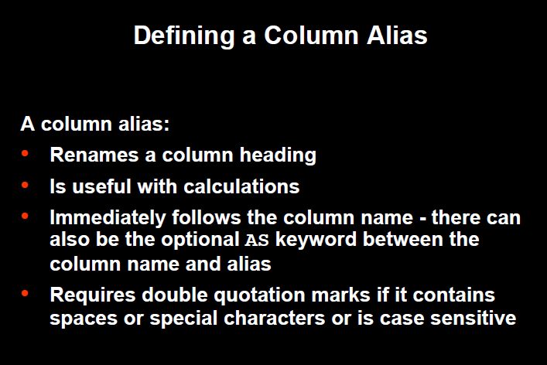

Slide 40
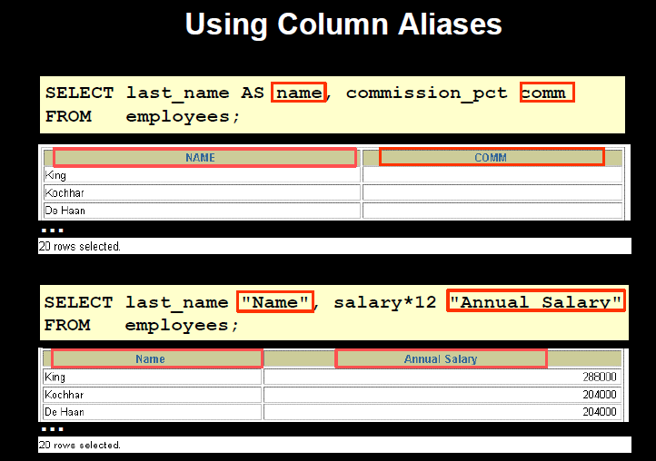

Slide 41
Aggregate Functions
Aggregate functions are functions that take a collection of values as input and return a single value.
The SQL Aggregate Functions are functions that provide mathematical operations like add, count or avg.
Behavior of Aggregate Functions:
    Operates - on a single column
    Return - a single value.

Slide 42
Types of SQL Aggregate Functions
SUM
AVG
MIN
MAX
COUNT
Operates only on collection of numbers.
Operates on numbers and non numbers as well.

Slide 43
SUM()
The sum of the values in a specified column.
Syntax:
Select SUM (column name) from <table name> where <condition>; OR
For Example: Select SUM (salary) from client ;
OR
Select SUM (salary) AS Total_Salary from client ;
Sum(salary) OR Total_Salary
29000 29000

Slide 44
AVG()
The average of the values in a specified column.
Syntax:
Select AVG (column name) from <table name> where <condition>;
For Example: Select AVG (salary) from client ;
AVG(salary)
9.666666

Slide 45
Min()
It returns the smallest values in a specified column.
Syntax:
Select MIN (column name) from <table name> where <condition>;
For Example: Select MIN (sell_price) from product ;
Min(marks)
9

Slide 46
Max()
It returns the maximum value in a specified column.
Syntax:
Select MAX (column name) from <table name> where <condition>;
For Example: Select MAX (salary) from client ;
Max(marks)
10

Slide 47
COUNT()
Returns the Number of records in a specified column where expression is not null.
Syntax:
Select COUNT (Column Name) from <Table Name>;
For Example:
Select COUNT (name) from client;
COUNT(name)
3

Slide 48
COUNT(*)
Returns the total Number of records in a specified column.
Syntax:
Select COUNT (*) from <Table Name>;
For Example:
Select COUNT (*) from client;
COUNT(*)
5

Slide 49
Logical Operators
AND : It is used for creating SQL statement with two or more conditions and all conditions must be satisfied.
OR : It is used for creating SQL statement with two or more conditions and any one condition should be satisfied.
3. NOT : It is used for displaying those records which does not satisfy the condition.

Slide 50
AND:
Find out the client no, name and salary of those clients who live in mumbai city and due balance is greater than and equal to 1000
SQL> Select client_no, name, salary from client_master where city=‘mumbai’ AND Bal_Due >=1000;
Client_no | Name | Salary
C001 | Ivan | 4000
C005 | Lara | 2000

Slide 51
OR:
Find out the client no, name and salary of those clients who live in mumbai city or due balance is greater than and equal to 1000
SQL> Select client_no, name, salary from client_master where city=‘mumbai’ OR Bal_Due >=1000;
Client_no | Name | Salary
C001 | Ivan | 4000
C004 | William | 6000
C005 | Lara | 2000

Slide 52
NOT:
Find out the client no, name and salary of those clients who are not in the city ‘mumbai’ and balance is not greater than 1000
SQL> Select client_no, name, salary from client_master where NOT ( city=‘mumbai’ AND Bal_Due >1000);
Client_no | Name | Salary
C002 | Ivan | 4000
C003 | Harry | 3000
C004 | William | 6000
C005 | Lara | 2000

Slide 53
Arithmetic Operators
Addition (+)
Subtraction (-)
Division (/)
Multiplication (*)
Enclosed Operation ()

Slide 54
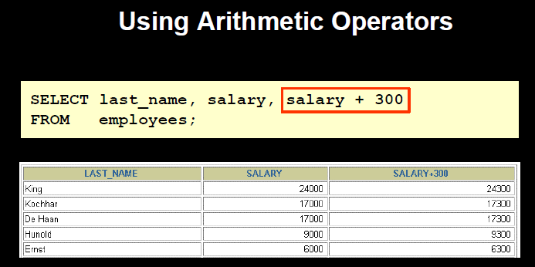

Slide 55
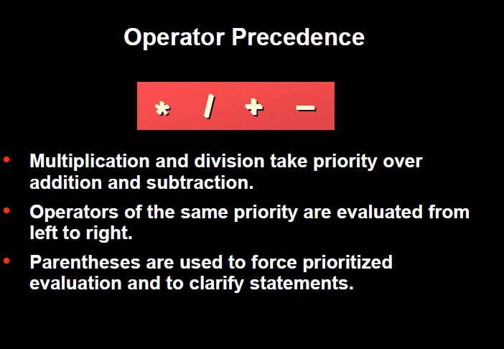

Slide 56
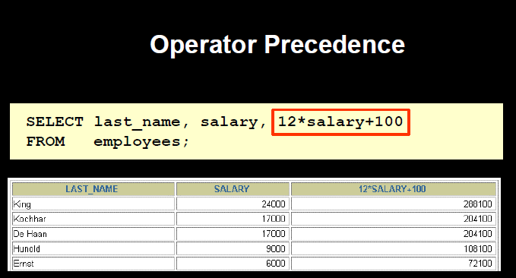

Slide 57
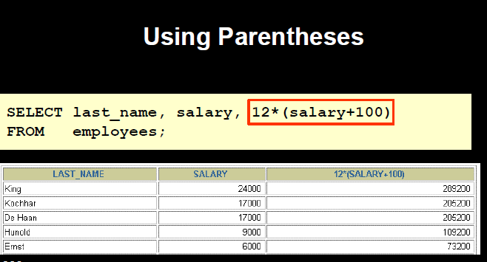

Slide 58
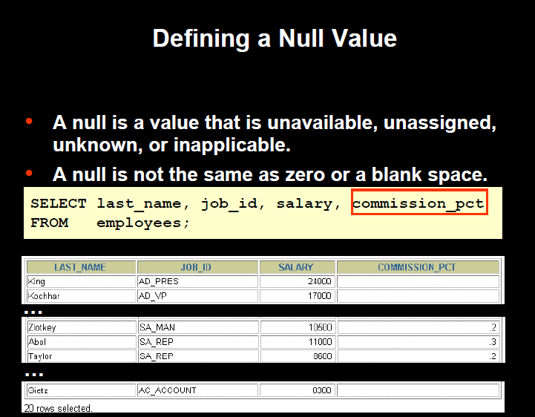

Slide 59
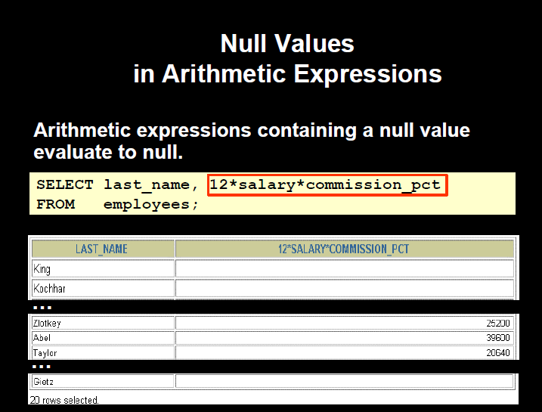

Slide 60
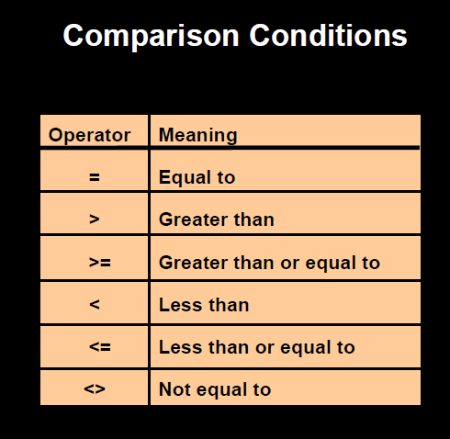

Slide 61
Range Searching (Between Operator)
Retrieve data within range of values.
BETWEEN operator allows the selection of rows that contains values within specified limit.
The range coded after the word BETWEEN in inclusive and two values in between the range must be linked with a keyword AND.
Syntax: Select * from <table name> where condition BETWEEN <expression> AND <expression>

Slide 62
Select description from product where sellprice BETWEEN 100 AND 300
Description
Books
Pens
Bags
Pencils
Select description from product where sellprice NOT BETWEEN 100 AND 300
Description
Folders

Slide 63
IN Operator
To test for values in a list.
Syntax: Select * from <TableName> where condition IN (expression);
Select name from client where salary IN (4000, 3000)

Slide 64
Rules of Precedence
Order | Operator
1 | Arithmetic Operators (**, * ,/, +, -)
2 | Comparison Operators
3 | IN
4 | BETWEEN
5 | Logical Operators (NOT, AND, OR)

Slide 65
Set Operations
SQL supports few SET Operations on data table.
These functions are used to get meaningful results from different conditions.
There are 3 types of Set operations:
  UNION, UNION ALL (U)
  INTERSECT, INTERSECT ALL (∩)
  EXCEPT (-)

Slide 66
Set Operation: UNION
It is used to store result of two or more select statement.
It will eliminate duplicate records from the result after combining two or more select statement.
In Union operation- number of columns and datatype should be same in both tables.
Syntax:
select <column name> from table name1 UNION select <column name> from table name2
OR
select <column name> from table name 1 where condition UNION select <column name> from table name 2 (or 1) where condition

Slide 67
Client_ID | Name
c001 | Ivan
c002 | John
Cust_ID | Name
c002 | John
c003 | William
C004 | Lara
CLIENT
Employee
select clinet_id, name from CLIENT UNION select cust_id, name from employee
Client_ID | Name
c001 | Ivan
c002 | John
C003 | Willaim
c004 | Lara

Slide 68
select client_id, name From CLIENT UNION ALL select clust_id, name from CUSTOMER
Client_ID | Name
c001 | Ivan
c002 | John
C002 | John
c003 | William
c004 | Lara

Slide 69
Set Operation: INTERSECT
It is used to combine two select statement or tables and return the common result.
In intersect operation, number of columns and datatype should be same in both tables or statements.
Syntax:
select <column name> from table name1 INTERSECT select <column name> from table name2
OR
select <column name> from table name 1 where condition INTERSECT select <column name> from table name 2 where condition

Slide 70
Client_ID | Name
c001 | Ivan
c002 | John
Cust_ID | Name
c002 | John
c003 | William
C004 | Lara
CLIENT
Employee
select clinet_id, name from CLIENT INTERSECT select cust_id, name from Employee
Client_ID | Name
c002 | John

Slide 71
Set Operation: EXCEPT OR MINUS
Combine results of two select statement and return only those results which is in first set.
Syntax:
select <column name> from table name1 minus select <column name> from table name2
OR
select <column name> from table name 1 where condition minus select <column name> from table name 2 where condition

Slide 72
Client_ID | Name
c001 | Ivan
c002 | John
Cust_ID | Name
c002 | John
c003 | William
C004 | Lara
CLIENT
CUSTOMER
select clinet_id, name from CLIENT Minus select cust_id, name from CUSTOMER
Client_ID | Name
c001 | Ivan

Slide 73
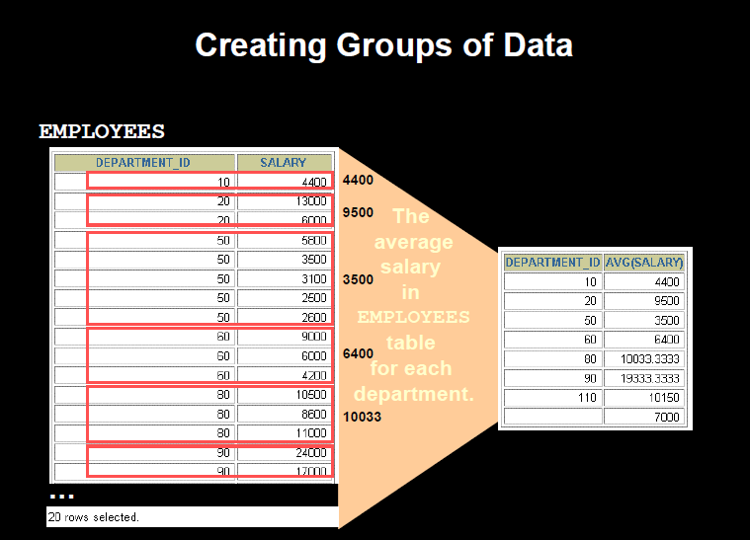
GROUP BY CLAUSE

Slide 74
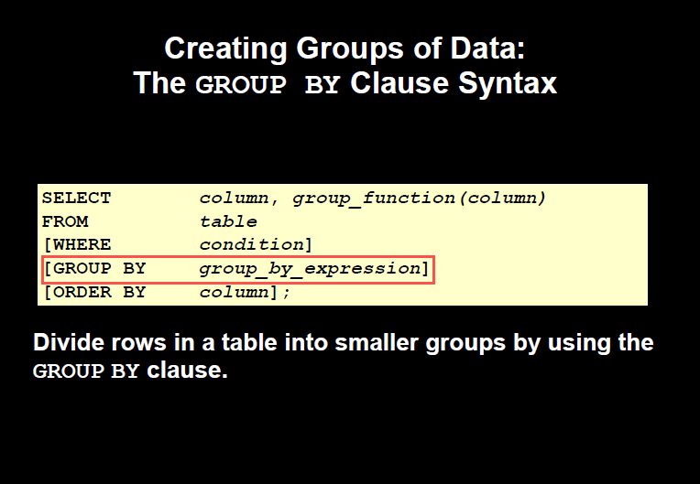

Slide 75
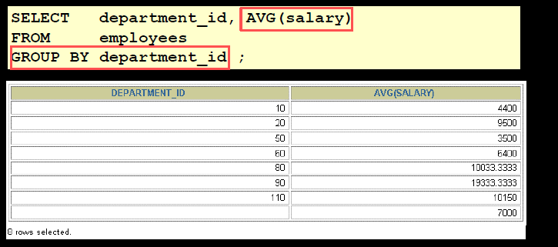

Slide 76
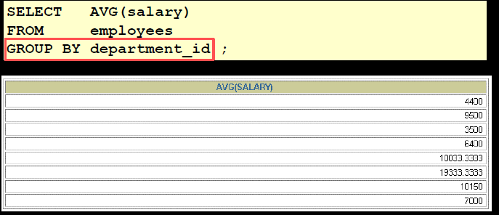

Slide 77
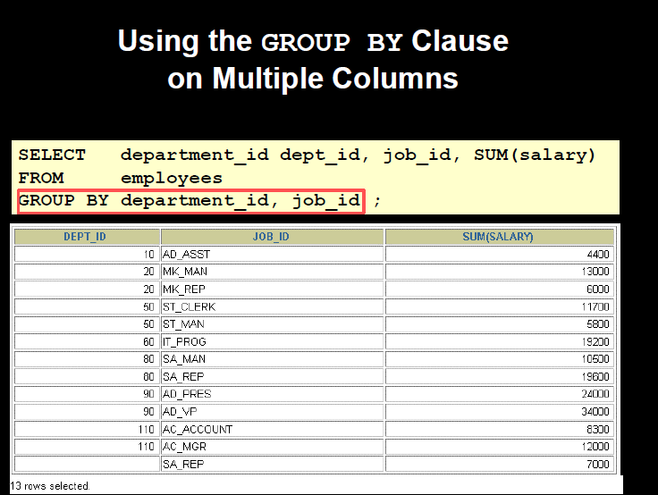

Slide 78
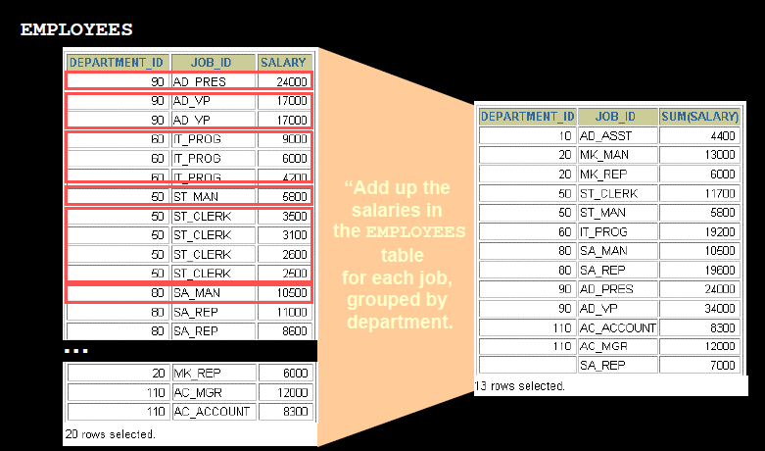

Slide 79
Having clause
The HAVING clause specifies conditions that filter which group results appear in the final results.
The WHERE clause places conditions on the selected columns, whereas the HAVING clause places conditions on groups created by the GROUP BY clause.
The HAVING clause must follow the GROUP BY clause in a query and must also precede the ORDER BY clause if used.
Syntax:
SELECT column1, column2 FROM table WHERE [ conditions ] GROUP BY column HAVING [ conditions ] ORDER BY column

Slide 80
Find out the product description and total quantity according to their product description which is having average sell price greater than 100.
Select description , count (quantity_on_hand) from products GROUP BY description HAVING avg(sell-price)> 100;

Slide 81
Pattern Matching:
Use of LIKE Predicate
The LIKE operator is used to search for a specified pattern in a column.
The SQL LIKE condition can be used in any valid SQL statement : Select, Insert, Update and Delete
The patterns that can be chosen from wild cards (%, _ )
% allows to match any string of any length (including zero length)
_ allows to match on a single character
Syntax: SELECT column_name(s) FROM table_name WHERE column_name LIKE pattern;

Slide 82
Customer
Cust_ID | Name
c002 | John
c003 | Jini
C004 | Lara
C005 | William
Retrieve the customers records whose name starting with ‘J’
select Cust_ID, Name from customer where Name LIKE ‘J%’ ;
Retrieve the customers records whose name begins with ‘La’
select Cust_ID, Name from customer where Name LIKE ‘La%’ ;
Retrieve the customers records whose name ending with ‘I’
select Cust_ID, Name from customer where Name LIKE ‘%i’ ;

Slide 83
Retrieve the customers records whose names have second character as o or I
select Cust_ID, Name from customer where Name LIKE ‘_o%’ or Name Like ‘_i%’ ;
Retrieve the customers records whose names have second last character as n
select Cust_ID, Name from customer where Name LIKE ‘%n_%’;
Retrieve the customers records whose names starts with ‘w’ and third last character is ‘a’
select Cust_ID, Name from customer where Name LIKE ‘W%a__%’;

Slide 84
Return the employee records whose employee name contains the letter ‘s’
Select * from employee where Name Like ‘%s%’;
EMP-ID | NAME | SALARY
1002 | Jane Anderson | 5750
1003 | Brad Everest | 71000
1004 | Steven | 57890
Return the employee records whose salary is of 4 digits and starting with 57
Select * from employee where salary LIKE ‘57__’;
EMP-ID | NAME | SALARY
1002 | Jane Anderson | 5750
Return the employee records whose salary starts with 57
Select * from employee where salary LIKE ’57%’;
EMP-ID | NAME | SALARY
1002 | Jane Anderson | 5750
1004 | Steven | 57890

Slide 85
Not LIKE
Using the NOT keyword allows you to select records that does NOT match the pattern.
Syntax: SELECT column_name(s) FROM table_name WHERE column_name NOT LIKE pattern; ( or <> LIKE pattern)
Retrieve the customers records whose names do not start with ‘J’
select Cust_ID, Name from customer where Name Not LIKE ‘J%’ ;
Retrieve the customers records whose names do not have pattern ‘oh’
select Cust_ID, Name from customer where Name NOT LIKE ‘%oh%’ ;

Slide 86
The Oracle Table- DUAL
DUAL is a dummy table owned by system. System has its own data dictionary and DUAL is a part of this dictionary.
DUAL is a oracle table which contains a single row and single column.
For viewing table structure
DESC DUAL ;
b) For retrieving records from DUAL table
Select * from DUAL;

Slide 87
Apply Arithmetic Operation
Select 2*2 from DUAL;
Select ¾ from DUAL;
SYSDATE
Select SYSDATE from DUAL;

Slide 88
Numeric Functions
ABS : Returns absolute value on ‘n’ from either DUAL or created Table.
Syntax: ABS(n)
Select ABS(-20) “Absolute” from DUAL;
Output: Absolute
-----------------------------------
20
2. POWER : Returns m raised to the nth power. N must be an integer.
Syntax: POWER( m, n)
Select POWER(3, 2) “Power” from DUAL;
Output: power
-------------------------------
9

Slide 89
ROUND: Returns rounded value
Syntax: ROUND(n[m])
Select ROUND(23.66, 1) “ROUND” from DUAL;
Round
---------------------------
23.7
4. SQRT: Return square root on n.
Syntax: SQRT(n)
Select SQRT(16) “Square Root” from DUAL;
Square Root
---------------------------------------------
4
5. GREATEST : Returns greatest value
Syntax: GREATEST(expr1, expr2, …exprn)
Select GREATEST(16, 20, 25) “GREATEST” from DUAL;

Slide 90
6. LEAST: Returns smallest value
Syntax: LEAST(expr1, expr2, …exprn)
Select LEAST(16, 20, 25) “LEAST” from dual;
LEAST
----------------------
16
7. MOD: Returns the remainder of a first number divided by second number
Syntax: MOD(m, n)
Select MOD(15, 7) “MOD” from DUAL;
MOD
---------------------
1
8. TRUNC: Returns a number truncated to a certain number of decimal places
Syntax: TRUNC(number, [decimal place] )
Select TRUNC(125.342, 1) “TRUNC” from DUAL;
TRUN
------------------------
125.3

Slide 91
9. FLOOR: Returns the largest integer value that is equal to or less than number
Syntax: FLOOR(n)
Select FLOOR(24.8) “FLOOR” from DUAL;
FLOOR
-------------------------
24
10. CEIL: Returns the smallest integer value that is equal to or greater than number
Syntax: CEIL(n)
Select CEIL(24.8) “ceil” from DUAL;
ceil
-----------------
25

Slide 92
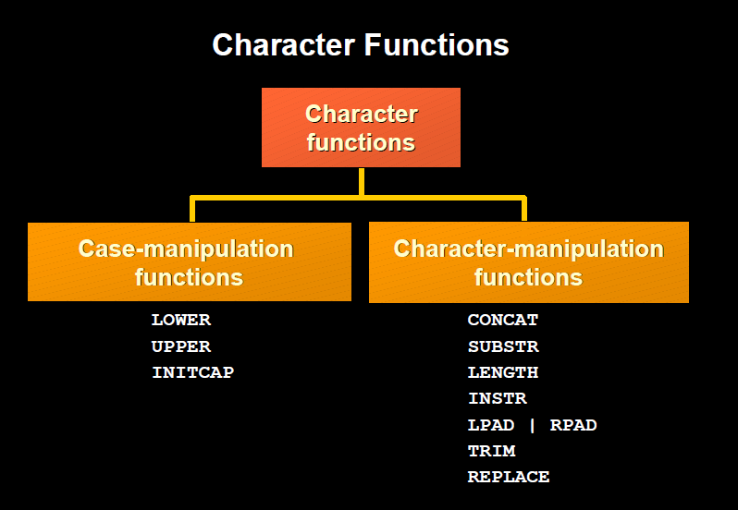

Slide 93
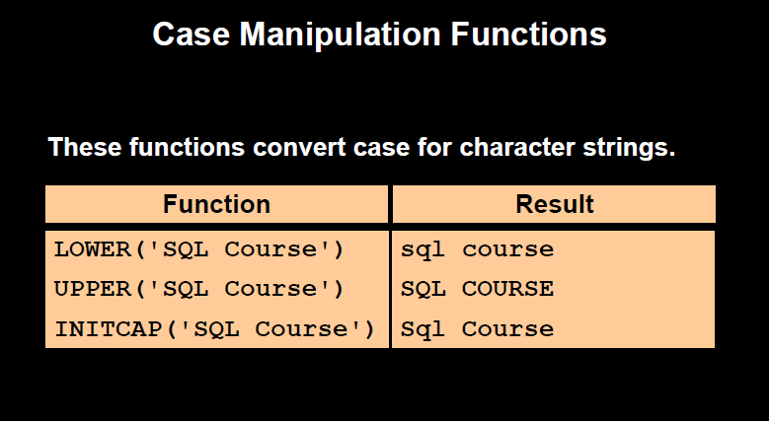

Slide 94
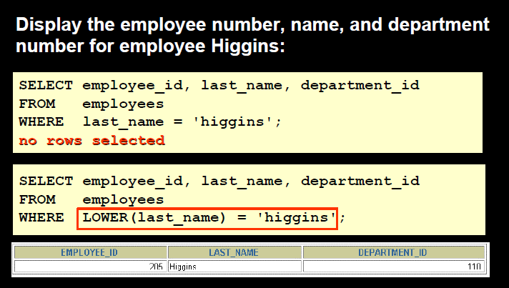
Syntax:
Select LOWER (‘SQL course’) from dual;
Select UPPER (‘Sql Course’) from dual;
Select INITCAP (‘SQL COURSE’) from dual;

Slide 95
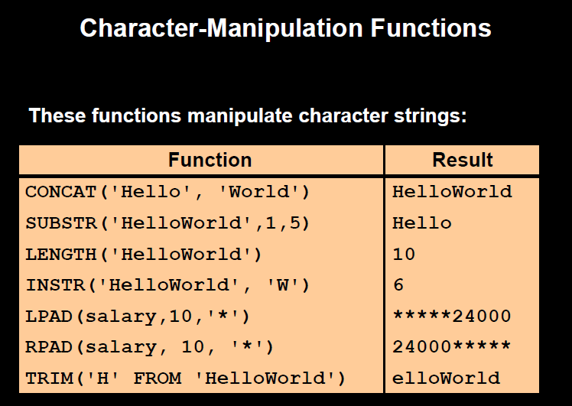

Slide 96
Select CONCAT (‘hello’, ‘world’) from dual;
Select SUBSTR (‘DATABASE’, 3, 4) from dual;
Select ASCII (‘a’), ASCII (‘B’) from dual;
Select Length (‘SQL’) from dual;
Select LTRIM (‘DBMS’, ‘D’) from dual;
Select RTRIM (‘DBMS’, ‘S’) from dual;
Select LPAD (‘SQL’, 6, ‘*’) from dual;
Select RPAD (‘SQL’, 6, ‘*’) from dual;
Select INSTR (‘HelloWorld’, ‘W’) from dual;

Slide 97
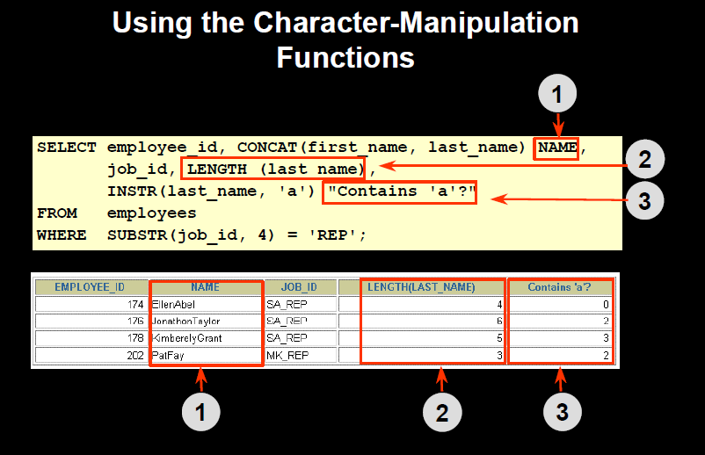

Slide 98
Working with Dates
Create Table: Date is a datatype and bydefault format is “DD-MON-YY’’
Insert Values: Enter value according to the data format.
Example: Create table Employee (DOB date);
Insert into Employee values (‘21-JUL-92’);
Column Name
Datatype

Slide 99
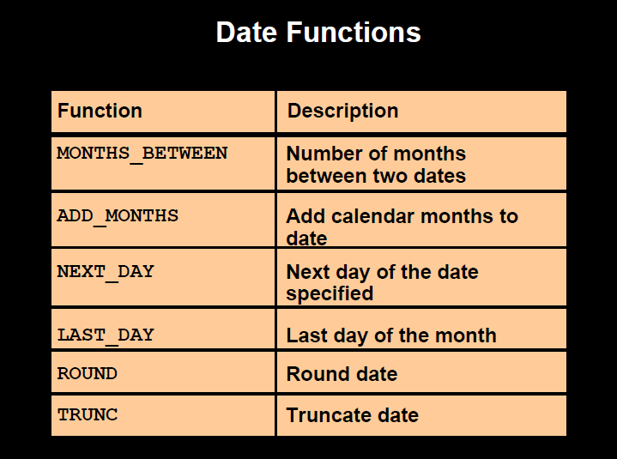

Slide 100
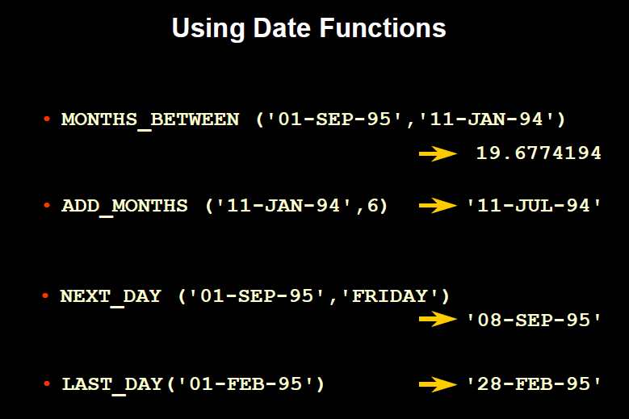

Slide 101
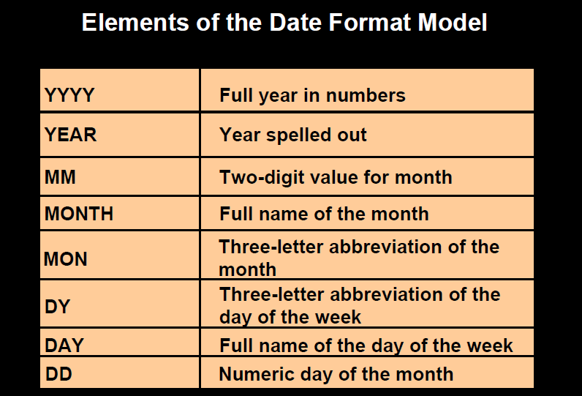

Slide 102
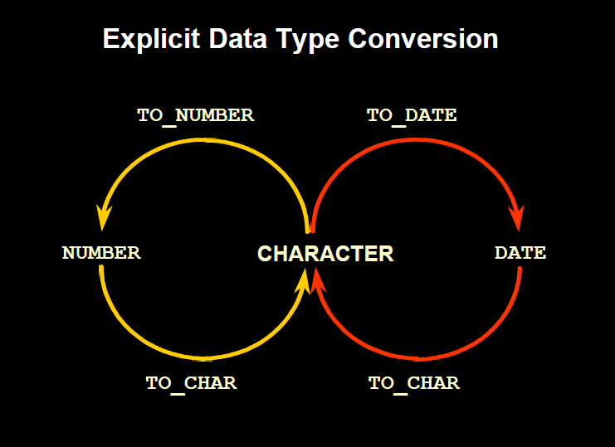

Slide 103
To_CHAR ()
Retrieval date into different format from the default format.
It converts date value into character values
Syntax: To_Char (<date value> [<fmt>]
where date value = date and fmt = format of output date
Example:
Select To_Char(SYSDATE, ‘DD-MM-YY’) from Dual;
Output: 21-09-13

Slide 104
To_Date ()
It converts character values into date value
Syntax: To_date(<char value> [<fmt>]
where char value = date and fmt = format of output date (bydefault system date)
Example:
Select To_date(’21/09/13’, ‘DD/MM/YY’) from Dual;
Output: 21-SEP-13

Slide 105
Data Constraints in SQL
SQL constraints are used to specify rules for the data in a table
Constraints can be specified during Create Table and Alter Table
In SQL, we have the following constraints:
NOT NULL - Indicates that a column cannot store NULL value
UNIQUE - Ensures that each row for a column must have a unique value
PRIMARY KEY - A combination of a NOT NULL and UNIQUE. Ensures that a column (or combination of two or more columns) have an unique identity which helps to find a particular record in a table more easily and quickly

Slide 106
FOREIGN KEY - Ensure the referential integrity of the data in one table to match values in another table
CHECK - Ensures that the value in a column meets a specific condition
DEFAULT - Specifies a default value when specified none for this column
Syntax:
CREATE TABLE table_name ( column_name1 data_type(size) constraint_name, column_name2 data_type(size) constraint_name,…….);

Slide 107
Data Constraints: Not Null
The NOT NULL constraint enforces a column to NOT accept NULL values.
The NOT NULL constraint enforces a field to always contain a value. This means that you cannot insert a new record, or update a record without adding a value to this field.
For Example:
Create table Bank( Bank_ID int Not Null, Branch_Name varchar2(10), Loan_No Varchar2(10) not null);
Insert into Bank Values (11, ‘Mumbai’, ‘L-201’);
Insert into Bank (Bank_ID) values (‘’);
Insert into Bank values (12, ‘Chennai’, ‘’);
Alter table Bank Modify (Loan _no Varchar2(10) Not Null);
Error in both commands

Slide 108
Data Constraints: Primary Key
Primary key is used to identify unique records
It can not accept null values
In primary key, the data held across the column must be unique
Only one primary key is allowed per table
One table can combine upto 16 columns in composite primary key (or candidate key)
Syntax: <Column Name> <data type size> Primary key
Create table Loan ( loan_number varchar2(10) Primary key, customer_name varchar2(10) );
OR
Create table customer (cust_no int , name varchar2(10), city varchar2(10), primary key (cust_no, city));
Alter table cust2 ADD Primary Key (Cust_no);
Composite Key

Slide 109
Composite key
Cust_ No | Name | City
201 | William | Mumbai
202 | John | Delhi
203 | Lara | Banglore
204 | John | Calcutta
Customer
Primary Key
Loan_No | Customer_name
11 | John
12 | Crist
13 | King
Loan

Slide 110
Foreign Key (Referential Integrity) Constraint
Foreign key represents relationships between two tables
A foreign key is a column (or groups of columns) whose values are derived from the primary key of other table (master table)
Foreign key column can have null or duplicate records
Records can not be inserted into foreign key table is corresponding records in the master table does not exist
Records of the master table can not be deleted if corresponding records in foreign key table actually exist

Slide 111
Syntax:
<column name> <Data Type> References <Table Name> <column name>
For Example:
Create table emp_database (emp-no int primary key, name varchar2(10), designation varchar2(10) , L-no number (10) References Loan (Loan_no), salary number(5) );
OR
Alter table customer-master ADD Constraint F_ID Foreign Key (Ln_no) references Loan (Loan_no);

Slide 112
CHECK CONSTRAINT
The CHECK constraint is used to limit the value range that can be placed in a column.
Syntax:
<column name> <data type> CHECK (Condition)
For Example:
CREATE TABLE Persons ( P_Id int NOT NULL CHECK (P_Id>0),
LastName varchar2(20) NOT NULL, FirstName varchar(255),
Address varchar2(20) );
CREATE TABLE Customer ( C_Id int Primary Key ,
Name varchar2(20), address varchar2(20) ,
check (Name Like ‘C%’), Check(Name =UPPER(Name) );
c) Alter table cust_master ADD check (cust_no>1);

Slide 113
UNIQUE CONSTRAINT
The UNIQUE constraint uniquely identifies each record in a database table like primary key
Only difference is that we can have many UNIQUE constraints per table, but only one PRIMARY KEY constraint per table.
For Example:
CREATE TABLE Employee ( E_Id int NOT NULL Primary Key,
LastName varchar2(10) NOT NULL, FirstName varchar2(10) UNIQUE, Address varchar2(10) UNIQUE, City varchar2(10) );

Slide 114
VIEWS in SQL
A view is a virtual table contains rows and columns, just like a real table. The fields in a view are fields from one or more real tables in the database.
Syntax:
CREATE VIEW view_name AS SELECT column_name(s) FROM table_name WHERE condition
For Example:
Create View product_vw AS select description from product where city = ‘Mumbai’ Order by city
Create View product_vw AS select description, QTY from product where city = ‘Mumbai’ Group BY description;

Slide 115
Retrieving Records from View
Syntax:
Select column(s) from VIEW;
For Example:
Select description from product_vw;
To Delete VIEW:
Drop View <View Name>
NOTE– Update and Delete commands in view work same as work on table only difference is that use view name rather than table name

Slide 116
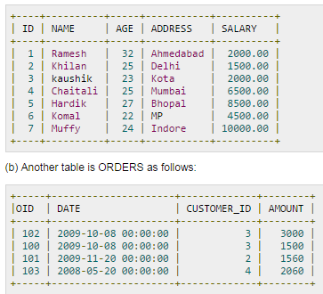
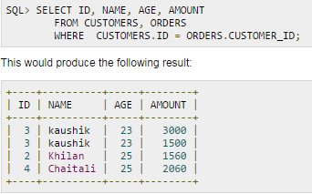
JOINS
SQL joins are used to combine rows from two or more tables based on a common field between them

Slide 117
In SQL, there are various types of joins:
  Natural Join
      Inner Join
      Equi Join
  Outer Join
      Left Outer Join
      Right Outer Join
      Full Outer Join
  Cross Join
Tables are joined on columns that have same datatype and size

Slide 118
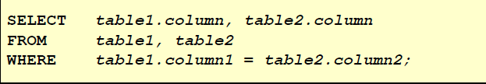
Inner Join
It is a natural join used for retrieving records from more than two tables having common data
Inner join can be Equi join if it is having equal condition only
Syntax:
Select column 1, column 2…., column N from Table 1 Inner Join Table 2 ON Table1.Column1= Table2.Column2 Where condition Order BY Column

Slide 119
Emp_No | Name | Dept_No
11 | Smith | B001
23 | William | B007
34 | Simi | C006
Dept_Name | Dept_No
CS | B001
EC | B007
CS | C009
CS | F007
Employee
Dept
List out the employee number, name along with department names to which they belong?
Select e.emp_no, e.name, d.dept_name from Employee e INNER JOIN Dept d ON d. dept_no= e. dept_no ;
Select e.emp_no, e.name, d.dept_name from Employee e, Dept d where d. dept_no= e. dept_ no ;

Slide 120
List out those employee details having name starts with S along with department names to which they belong?
Select e.emp_no, e.name, d.dept_name from Employee e INNER JOIN Dept d ON d. dept_no= e. dept_no where e.name LIKE ‘S%’ ORDER BY e. name ;
Select e.emp_no, e.name, d.dept_name from Employee e, Dept d where d. dept_no = e. dept_no and e.name LIKE ‘S%’ ORDER BY e. name ;

Slide 121
Employee
Emp_No | Name | Branch_No
11 | Smith | B001
23 | William | B007
34 | Simi | C006
List out the employee details along with their accounts and branch no of Mumbai branch
Select e.emp_no, e.name, a. acct_no, b.branch_no from Account a INNER JOIN Branch b ON a. branch_name = b. branch_name INNER JOIN employee e ON e.branch_no = b. branch_no
Acct_no | Branch_name
1008 | Mumbai
1007 | PUNE
1021 | Calcutta
Account
Select e.emp_no, e.ename,
a . acct_no, b. branch_no from account a, branch b, employee e where
a. branch_name = b.branch_name and
b.branch_no = e. branch_no
Branch_Name | Branch_No
Mumbai | B001
Mumbai | B007
Pune | C009
Banglore | F007
Branch

Slide 122
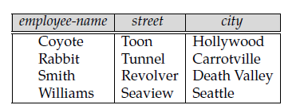
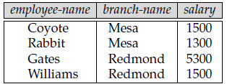
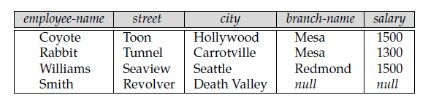
Left Outer Join
The LEFT JOIN keyword returns all rows from the left table (table1), with the matching rows in the right table (table2).
The result is NULL in the right side when there is no match.
Table 1
Table 2
Table 1 Left Join Table 2
Resultant Table

Slide 123
Emp_No | Name | Branch_No
11 | Smith | B001
23 | William | B007
34 | Simi | C006
List out the employee details along with their branch name using Left Outer Join
Employee
Branch_Name | Branch_No
Mumbai | B001
Mumbai | B007
Pune | C009
Banglore | F007
Select e.emp_no, e.name, b.branch_name from Employee e LEFT OUTER JOIN Branch b ON b. branch_no = e. branch no
Select e.emp_no, e.name, b.branch_name from Employee e, Branch b where b. branch_no = e. branch no (+);
Branch

Slide 124
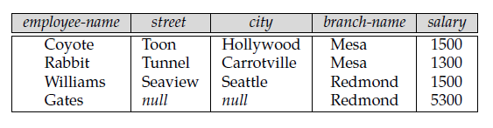
Right Outer Join
The Right JOIN keyword returns all rows from the right table (table2), with the matching rows in the left table (table1).
The result is NULL in the right side when there is no match.
Table 1
Table 2
Table 1 Right Join Table 2
Resultant Table

Slide 125
Emp_No | Name | Branch_No
11 | Smith | B001
23 | William | B007
34 | Simi | C006
List out the employee details along with their branch name using Right Outer Join
Employee
Select e.emp_no, e.name, b.branch_name from Employee e RIGHT OUTER JOIN Branch b ON b. branch_no = e. branch no
Branch_Name | Branch_No
Mumbai | B001
Mumbai | B007
Pune | C009
Banglore | F007
Select e.emp_no, e.name, b.branch_name from Employee e, Branch b where b. branch_no (+) = e. branch no;
Branch

Slide 126
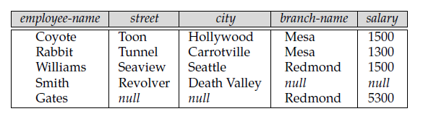
Full Outer Join
It does both of those operations, padding tuples from the left relation that did not match any from the right relation
As well as tuples from the right relation that did not match any from the left relation and adding them to the result of the join.
Table 2
Table 1
Table 1 Full Outer Join Table 2
Resultant Table

Slide 127
Emp_No | Name | Branch_No
11 | Smith | B001
23 | William | B007
34 | Simi | C006
List out the employee details along with their branch name using Full Join
Employee
Select e.emp_no, e.name, b.branch_name from Employee e FULL OUTER JOIN Branch b ON b. branch_no = e. branch no
Branch_Name | Branch_No
Mumbai | B001
Mumbai | B007
Pune | C009
Banglore | F007
Branch

Slide 128
SUBQUERIES
A subquery is a form of SQL statement that appears inside another SQL statement
Subquery also termed as Nested Queries
First table is called Parent statement which uses rows returned by subqueries
Subqueries can be used for
  Inserting records
  Creating table
  Update records

Slide 129
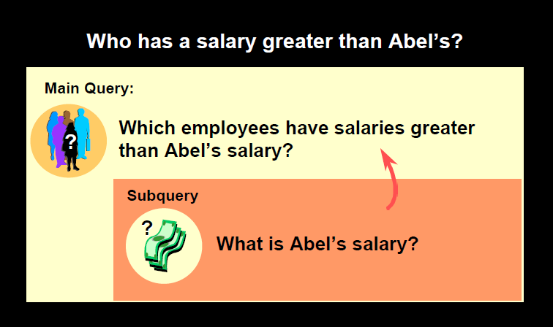

Slide 130
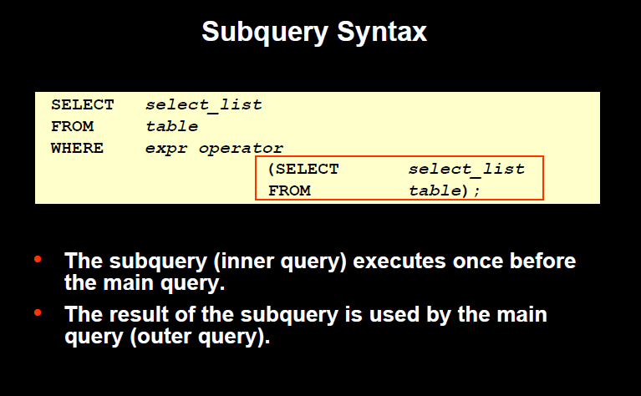

Slide 131
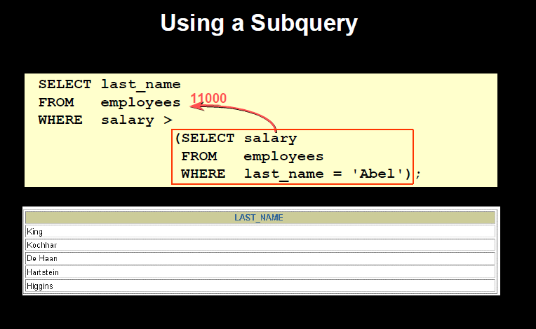
Retrieve last name of employees having salary greater than Abel’s salary

Slide 132
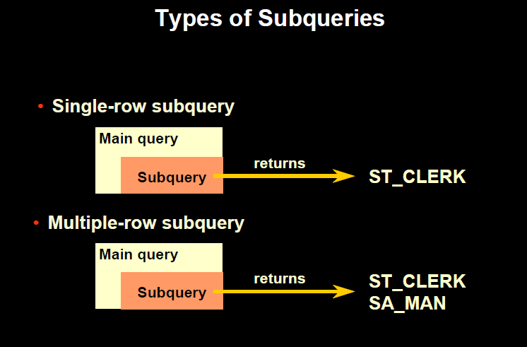

Slide 133
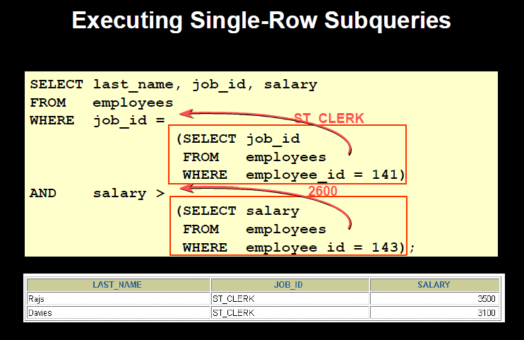
Retrieve the last name, job id and salary of the employees who are having same job id as employee id 141 and salary is greater than employee id 143

Slide 134
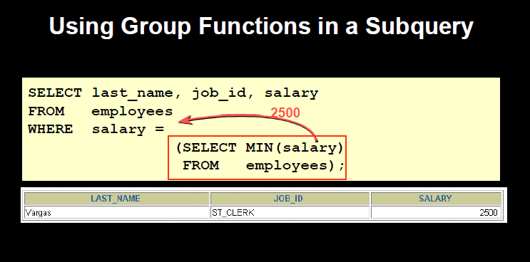
Retrieve the last name, job id and salary of the employee who has minimum salary in the department

Slide 135
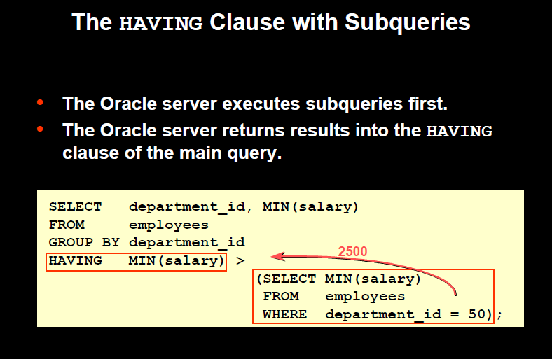
Retrieve the department id and minimum salary of employees as per their department id which is having minimum salary greater than minimum salary of those employees who work in department no 50

Slide 136
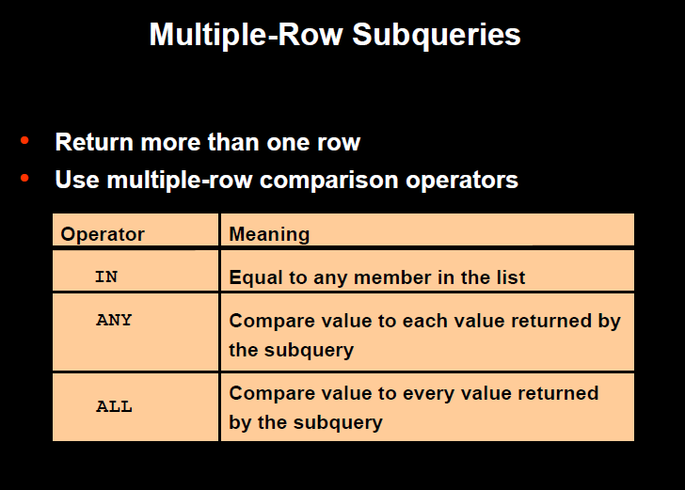

Slide 137
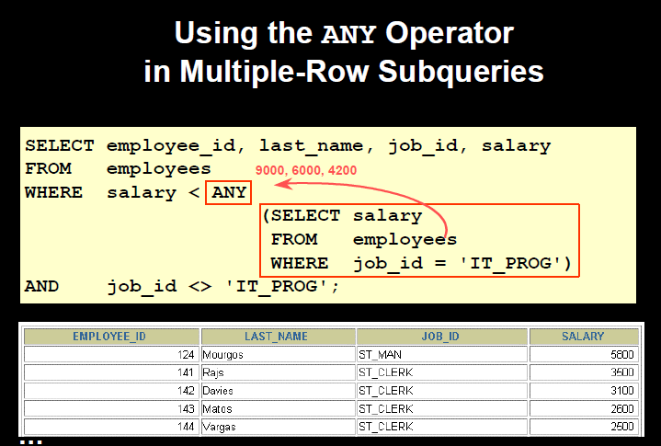
Retrieve the records of employee whose salary is less than any IT_Prog employee and job id should not be It_Prog

Slide 138
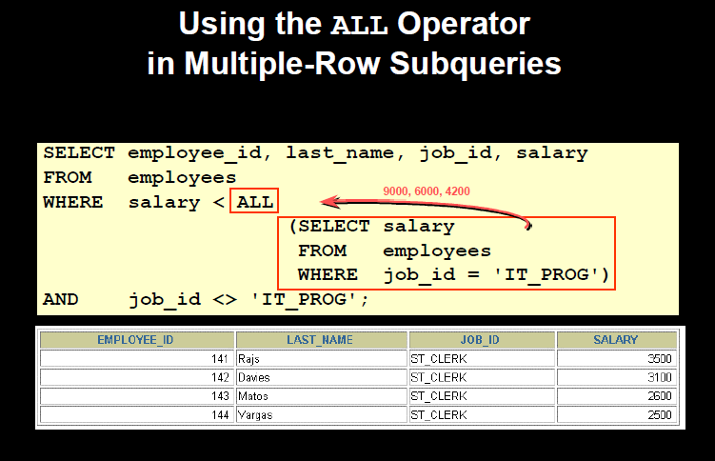
Retrieve the records of non IT_Prog employee whose salary is less than all IT_Prog employees

Slide 139


THANK YOU

